Slide 1
PERSONA- Your Companion Bot
Team Zenith| Hackathon 2025

Slide 2
Problem Statement
Problem Statement
As per recent nationwide surveys (2025), approximately 48% to 60% of students in higher education in India reported moderate to high levels of depression, anxiety, and stress [7]
7% of India’s total suicide deaths- students [7]
Indian students do not avail mental health services due to stigma, ignorance, cultural biases, and lack of resources[2]
Existing mental health chatbots offer surface-level comfort without real empathy or therapeutic depth.
Users often rely on these tools as substitutes instead of being encouraged to seek actual therapy.
Who is facing the issue?
Everybody can suffer from mental health issues, but predominantly university students because,
High academic pressure
Social and emotional adjustments
Financial stress
Stigma around seeking help
Why now?
Rising student stress and anxiety due to post pandemic academic pressures and competitive environments
Social and emotional challenges as students adjust to new lifestyles and relationships
Persistent stigma prevents many from seeking traditional therapy
Limited access to counsellors and mental health services on campuses
Technology readiness

Slide 3
Proposed Solution
Develop a gamified questionnaire based on DASS 21 & PHQ-9 questions [9]
Responses are scored, issues are detected and results are stored in university database for AI analysis
Designing a Multilingual companion bot ‘SERA’, specifically catering to the needs of students
Analysing the results from university database and categorizing the students into different distress level-Euthymia, PD1, PD2
Alerts the institutional psychiatrist if PD2 students are found for immediate action
Urges PD1 students using altruistic tone and context to seek medical support[3]
Uses CBT and DBT principles like AEI, Cognitive Mirror Mode, Cultural & Linguistic Empathy (Bernal and Colleague Framework), Wise Mind Mode[6]
Analyses the PD1 students to observe if their stress and anxiety is due to academic pressure. If so,
Provides time management schedule for efficient learning based on their daily behavioural pattern and university curriculum
Provides healthy and tasty diet plans based on their choices of food to relieve stress
Notifies the institution to take remedial actions like offering counselling services, conducting workshops on mental health, redefining success etc if number of students with PD1 and PD2 are high [PD: psychologically distressed]

Slide 4
Solution Overview
Technology Involved
An intelligent base model with further fine-tuning
NLP Sentiment & Emotion Detection
Context & Memory Management: adherence rates
Database/Cloud Storage
Frontend Interface
APIs for Crisis Support
Uniqueness/innovation
Emotionally & Culturally Adaptive: Learns user tone and mood (AEI) and adapts language/context (Bernal Framework)
Therapeutically Grounded: Uses CBT/DBT techniques, mini-therapy arcs, and Wise Mind/Comfort modes for guided support
Crisis-Aware & Ethical: Detects distress and compassion fatigue, escalates responsibly, with transparent data use
Progress-Focused: Monitors adherence rate to ensure meaningful engagement
Diet and schedule tracker for better mental wellness

Slide 5
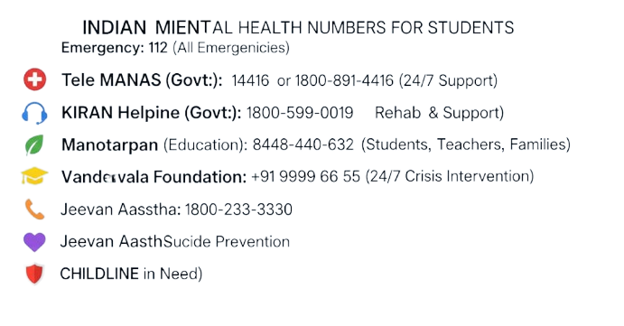
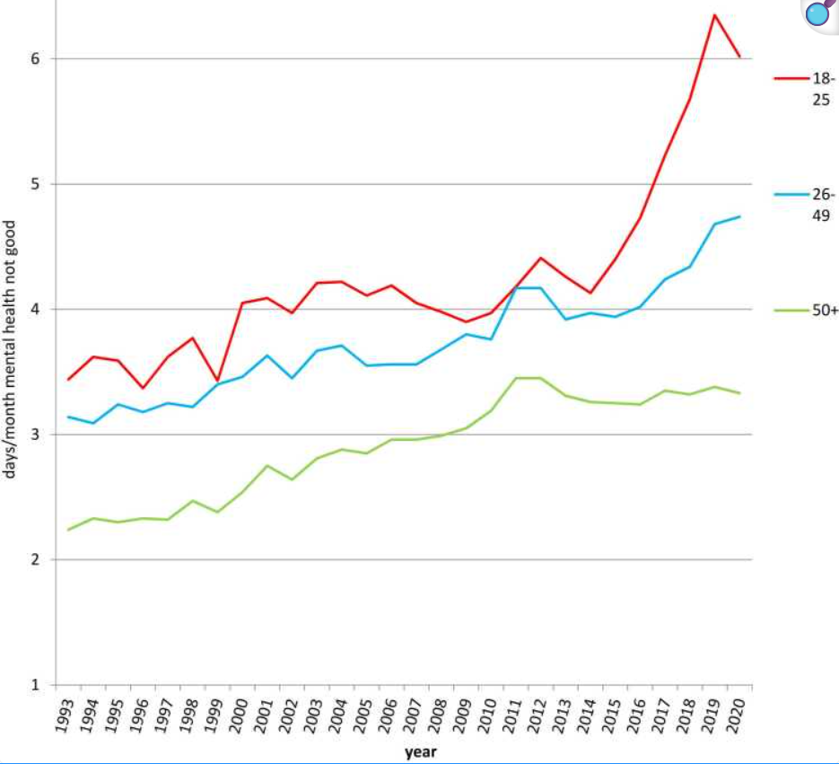
Desirability
Target Users :
Young adults and adolescents(university students) facing stress or anxiety
Why These Users?
Academic pressure, social adjustment, and career anxiety[3]
Stigma & Privacy Concerns: Hesitant to seek in-person therapy[1]
Digital Natives: Comfortable with AI interfaces for support
What main problem does it solve?
Early Identification: Detects stress, anxiety, or emotional distress through conversation and mood analysis
Guides Toward Real Therapy: Encourages users to seek professional help rather than relying solely on the chatbot
Bridges the Support Gap
Personalised Emotional Insight: Reflects user thoughts and moods to increase self-awareness and readiness for therapy
Helpline numbers:
[8]

Slide 6
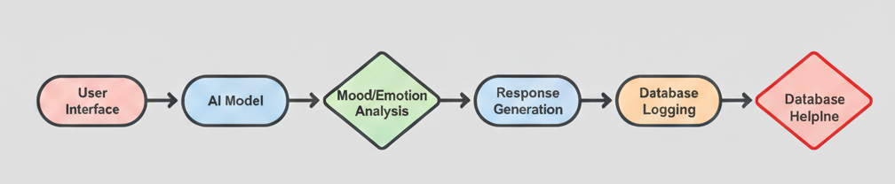
Feasibility
Tools & Platforms
Pre-trained models: conversational AI & CBT/DBT logic
Python / NLP Libraries: emotion detection, mood analysis
Frontend: HTML, CSS, Java script
Database: Flask+ SQLite
Resource Availability & Limitations
Available: Pre-trained model API access, cloud storage, Python libraries, web dev tools
Limitations: large-scale fine-tuning requires data and is not free, limited real-time emotion detection accuracy
Architecture plan:

Slide 7
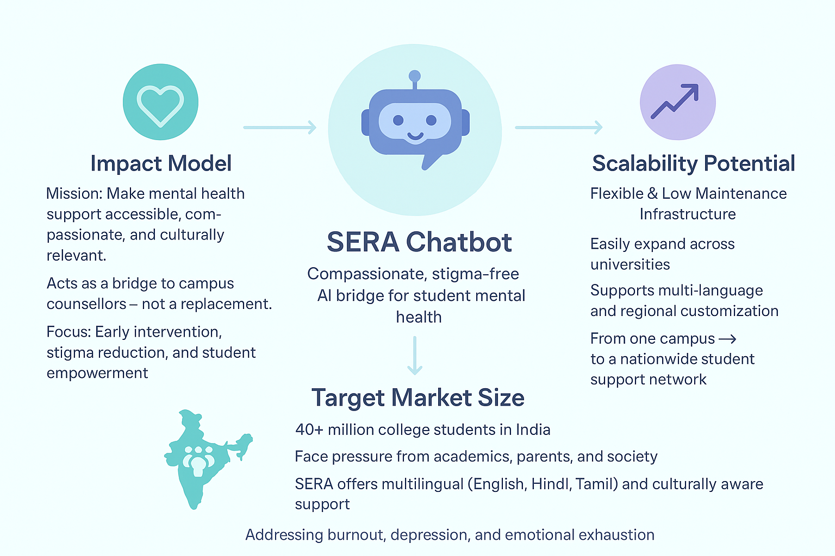
Viability

Slide 8
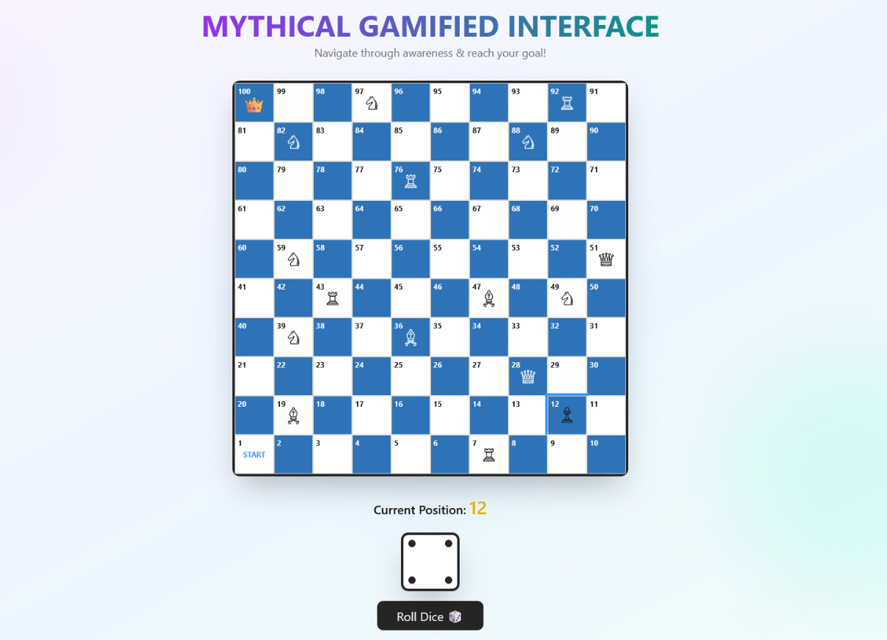
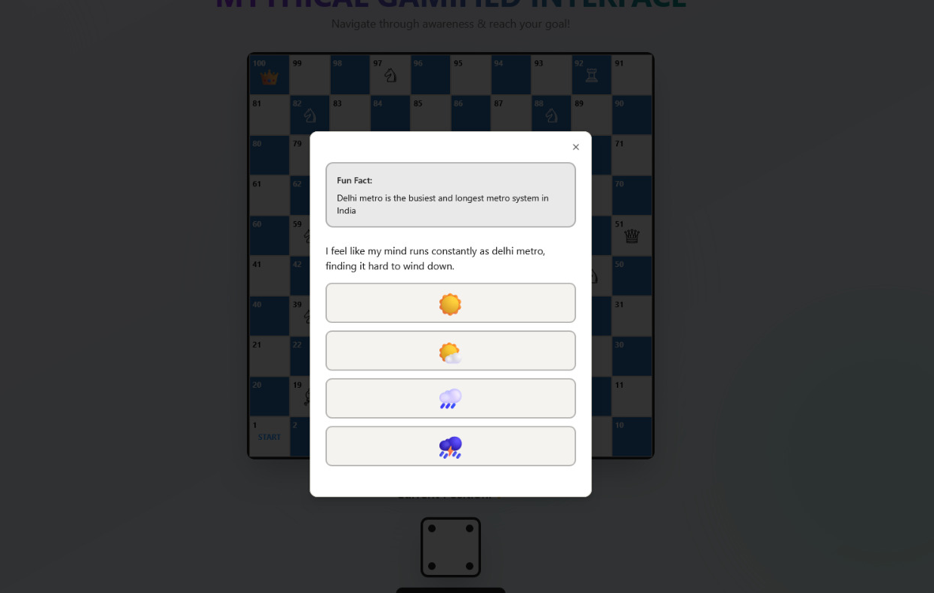
Prototype / Demo

Slide 9
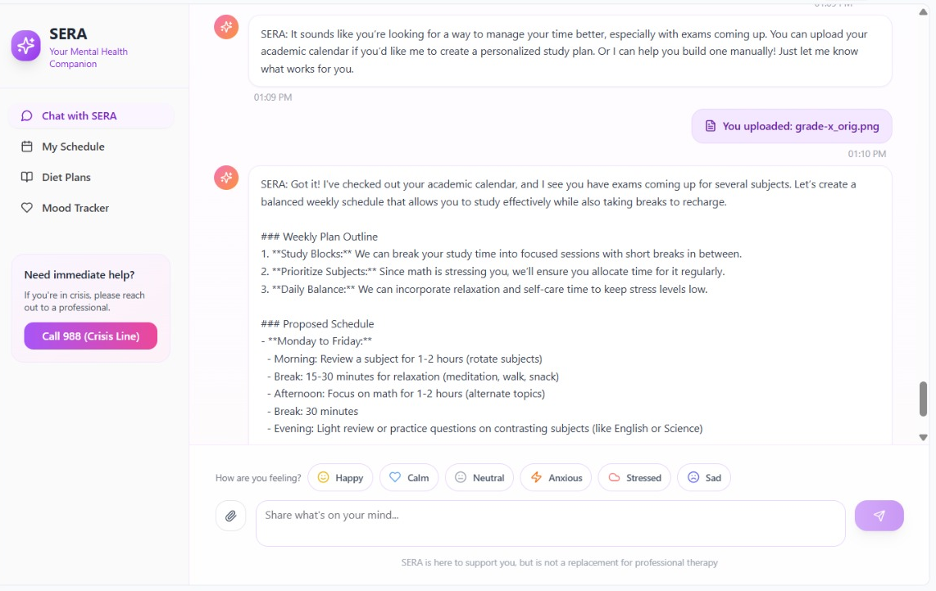
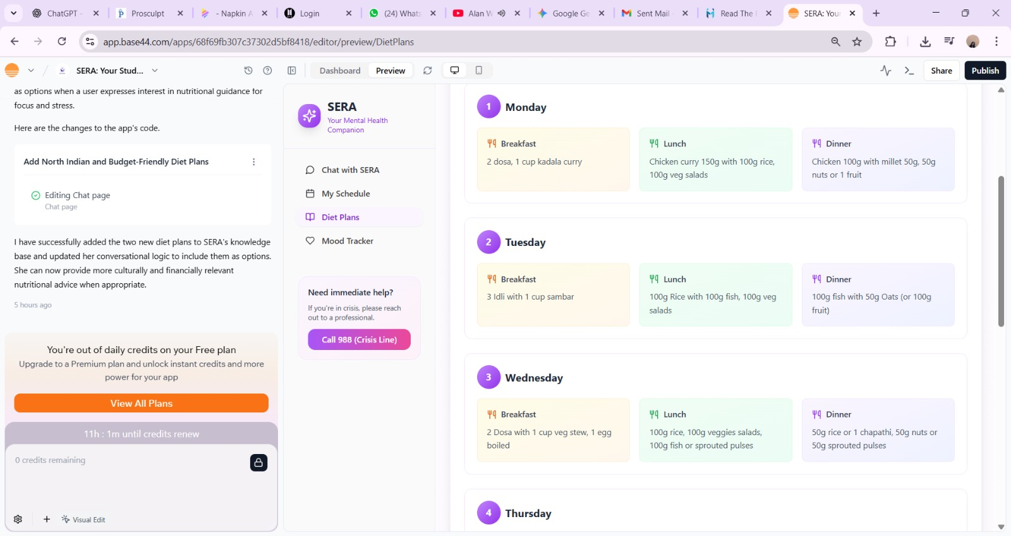
Prototype / Demo

Slide 10
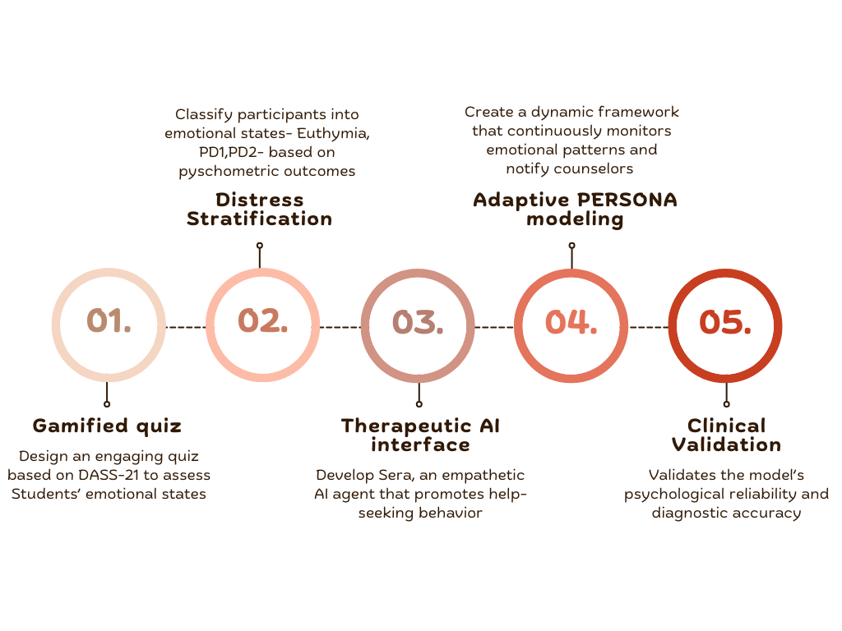
Roadmap

Slide 11
Team & Roles
Name | Role
Gayathiri S : AI-ML(Model training)
Mariyam Arshiya Saddiq Basha : Cloud computing
Karthiga M-:Frontend development
Kirishipathi B: Backend development
Harsha U: UI/UX
Capability
Our team is fully capable of carrying out this project because we combine strong technical expertise with a deep understanding of student mental health challenges. With members skilled in AI and database integration, we can build a secure and functional chatbot system.
Our awareness of psychological frameworks like CBT and DBT ensures that the chatbot remains compassionate and ethically designed, focusing on guidance rather than replacement of therapy.
Being students ourselves, we personally relate to the academic stress and stigma we aim to address, which helps us design a relatable and user-friendly experience.

Slide 12
References
Out with AI, in with the psychiatrist: a preference for human- derived clinical decision support in depression care. Marta M. Maslej, Stefan Kloiber , Marzyeh Ghassemi , Joanna Yu and Sean L. Hill. Translational Psychiatry (2023) 13:21.
Depression, anxiety, and stress among college students: a Kashmir-based epidemiological study Amrit Sudershan,Sumaira Rehman,Tafazul Manzoor,Basharat Shaban,Seerat Sultan Agar Chander Pushap,Srishty Sudershan,Mehraj Bashir,Showkat Ahmad MalikFront. Psychiatry, 10 September 2025Sec. Public Mental Health Volume 16 – 2025.
Empathy in AI: Developing a Sentiment-Sensitive Chatbot through Advanced Natural Language Processing. Dr.Mabrouka Abuhmida, Md Johirul Islam, Dr. Wendy Booth. Volume 13, No.3, May - June 2024International Journal of Advanced Trends in Computer Science and Engineering.
CheerBots: Chatbots toward Empathy and Emotion using Reinforcement Learning. Jiun-Hao Jhan Chao-Peng Liu Shyh-Kang Jeng Hung-Yi Lee. National Taiwan University, Taipei, Taiwan
Mental Health hatBot. Ms. Diksha Tanaji Kondhalkar, Mr. Shivam Chandrakant Dushman, Ms. Sakshi Rajkumar Gupta, Prof. Pournima Kamble Students, Department of Computer Technology, Lecturer, Department of Computer Technology. Bharati Vidyapeeth Institute of Technology, Navi Mumbai, Maharashtra, India
A Mental Health Chatbot with Cognitive Skills for Personalised. Behavioural Activation and Remote Health Monitoring. Prabod Rathnayaka , Nishan Mills , Donna Burnett , Daswin De Silva , Damminda Alahakoon and Richard Gray. Centre for Data Analytics and Cognition, La Trobe University, Bundoora, VIC 3086, Australia
https://m.economictimes.com/news/new-updates/world-suicide-prevention-day-2025-surge-in-student-suicides-outpaces-overall-trend-warn-experts/articleshow/123798622.cms
Increases in poor mental health, mental distress, and depression symptoms among U.S. adults, 1993–2020. Nikhila S. Udupa, Jean M. Twenge, Cooper McAllister, Thomas E. Joiner. Journal of Mood and Anxiety DisordersVolume 2, August 2023, 100013
https://pmc.ncbi.nlm.nih.gov/articles/PMC8063632/

Slide 13
Experts help needed in
Clinical Validation
Data Privacy & Consent
Cultural & Linguistic Sensitivity
Technical Validation
Institutional Collaboration

Slide 14
Thank You
• Contact details:
email:
gayu06sridhar@gmail.com
karthiga.mkrishnan07@gmail.com
linkedIn:
www.linkedin.com/in/gayathiri-sridhar-b94537314
https://www.linkedin.com/in/karthiga-m-124ba9375/
https://www.linkedin.com/in/kirishipathi-b-03250b328/
https://www.linkedin.com/in/mariyam-arshiya-0a4ab9300/
https://www.linkedin.com/in/harsha-shankar-b89521382/
Github:
https://github.com/gayathiri06sridhar
https://github.com/kirishipathi

